Slide 1
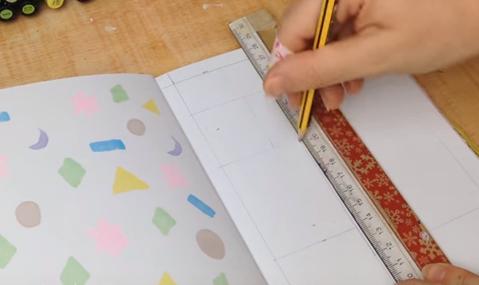
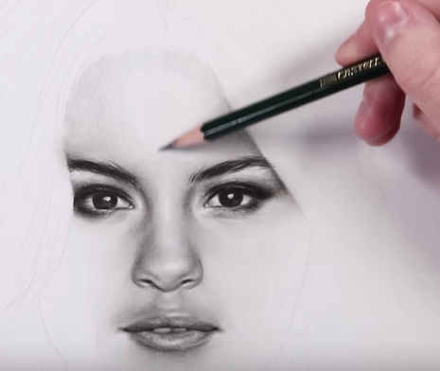
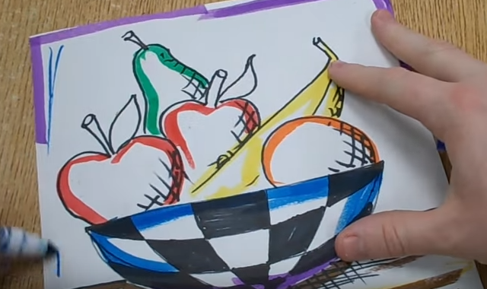
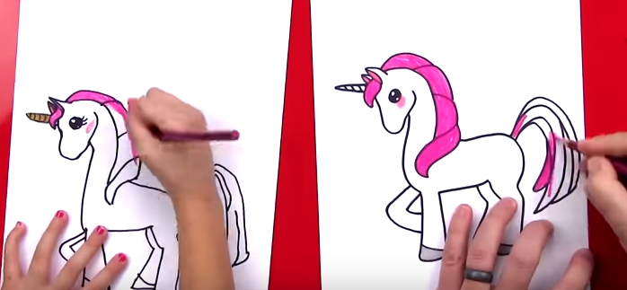
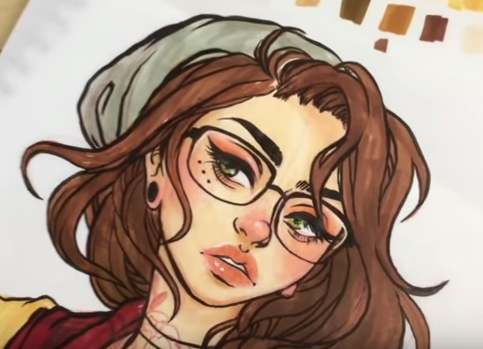
Arts & Crafts Ideas
How to scrap book: | https://www.youtube.com/watch?v=NUSToY5Celk
How to draw Lego Batman: | https://www.youtube.com/watch?v=M2RqSMVEHEk
How to make clay animals: | https://www.youtube.com/watch?v=dxuv0fv_eXk
The Dos and Don’t of drawing faces: | https://www.youtube.com/watch?v=y-hFyom8P1U
How to draw a still-life: | https://www.youtube.com/watch?v=hb7UY160r2Q
How to draw a 3D ladder (art tricks): | https://www.youtube.com/watch?v=OAq2X-0FbGM
How to draw a unicorn: | https://www.youtube.com/watch?v=r6cJl89axqY
How to use oil pastels to draw a landscape: | https://www.youtube.com/watch?v=CIpdQvSpPwo
Marker Pen Art: | https://www.youtube.com/watch?v=IGYwnaZYyPA
How to do a mixed media project: | https://www.youtube.com/watch?v=GRcFvyY8K6s

Slide 2


Out and about: Culture!
https://www.ceacard.co.uk/ - Get a CEA card and you can accompany your child to the cinema for free!
https://www.sciencemuseum.org.uk/see-and-do/early-birds - The museum opens early for families who need quieter times. Next one is Sat 14th July.
Waterman’s art centre Brentford: https://www.watermans.org.uk/whats-on/
There are always free exhibitions at the Tate Modern and Tate Britain: http://www.tate.org.uk/visit/tate-modern
Workshops for 8-14 year olds at the Tate Modern: http://www.tate.org.uk/whats-on/tate-modern/workshop/8-14-studio
Free exhibition at the National Portrait Gallery: https://www.npg.org.uk/whatson/bp-portrait-award-2018/exhibition/
1 day, 3 day, and evening exhibitions for 14-21 year olds: https://www.npg.org.uk/whatson/exhibitions/bp-portrait-award-next-generation/next-gen-whats-on/
V&A: https://www.vam.ac.uk/info/family-art-fun

